Slide 1
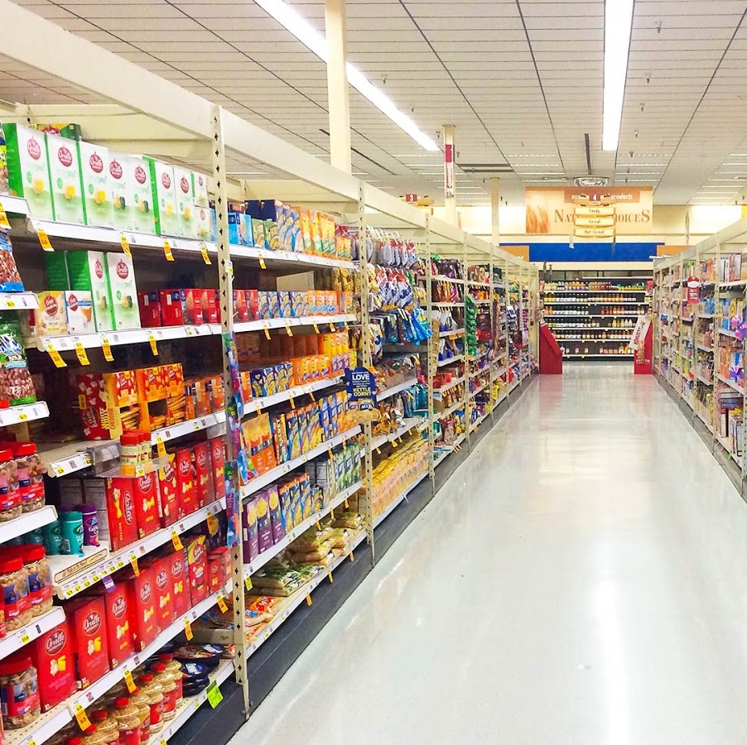
Retail Sales Prediction
MSBA 305 Term Project
Student: Yichun Chen
This Photo by Unknown author is licensed under CC BY-NC-ND.

Slide 2
Business Problem
Over-stocking and under-stocking both hurt profitability
Over-stocking: leads to food waste, increased inventory cost, etc
Under-stocking: misses revenue opportunity; also results in customer inconvenience and disappointment
Purpose of the study: to predict daily sales volume at store/product family level for a chain retailer located in Ecuador.
Notes:
Purpose of this study: predict short-term daily sales volume at store/product family level for an Ecuadorian chain retailer using a multiple regression model, based on a descriptive analysis of the historical daily sales records with a timeframe from January 1, 2013 to August 15, 2017.

Slide 3
Dataset
Downloaded from Kaggle
https://www.kaggle.com/competitions/store-sales-time-series-forecasting/data
Contains sales data from Corporación Favorita, a large Ecuadorian-based grocery retailer --- sells 33 product families at 54 stores.
Total observations: 3,029,400
Historical data timeframe: over 4 years (Jan. 2013 to Aug 15, 2017)
Forecast timeframe: the following half month (Aug 16 – Aug 31, 2017)

Slide 4
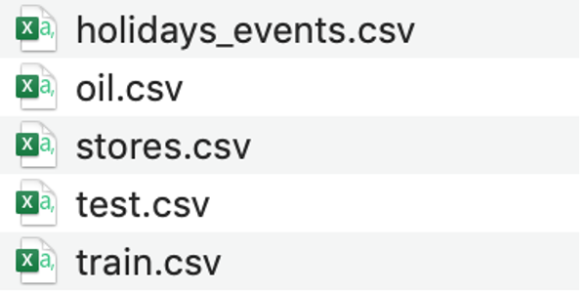
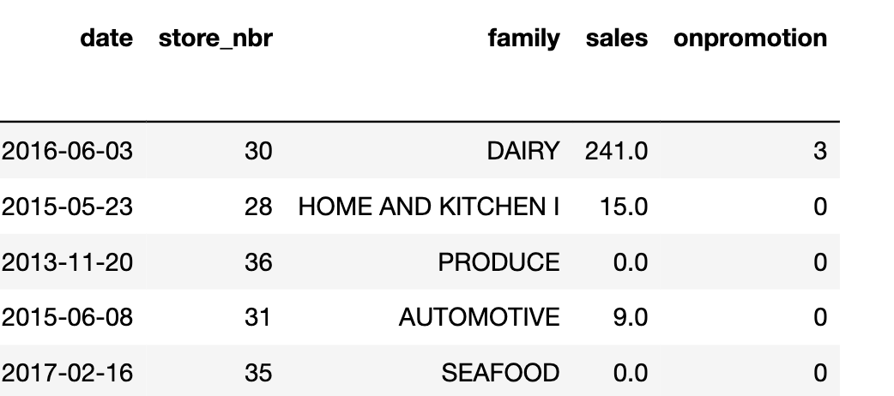
Dataset
5 tables:
“train.csv : this table contains historical daily sales records at store/product category level
“test.csv”: this table contains the same information as “train.csv” except for the missing sales volume column which awaits to be forecasted.
“stores.csv”: store location(city, state), store type and cluster
“oil.csv”: daily gas price
“holidays_events.csv”: national, regional and local holidays

Slide 5
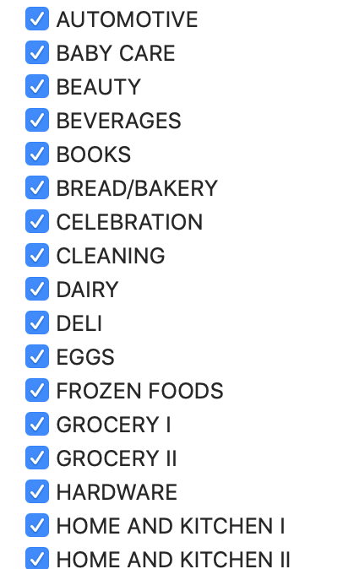
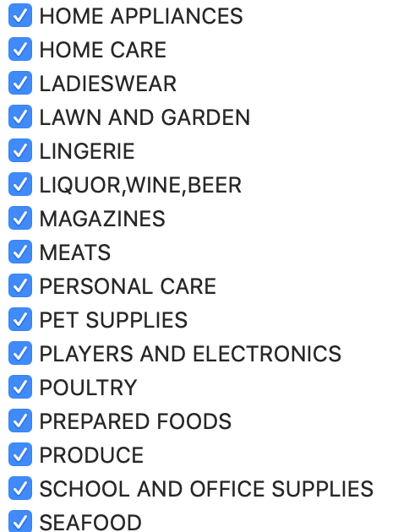
Predictive Goal: To predict daily sales volume for each of the 33 product families, in each of the 54 stores for the next half month (Aug 16, 2017 – Aug 31,2017)

Slide 6
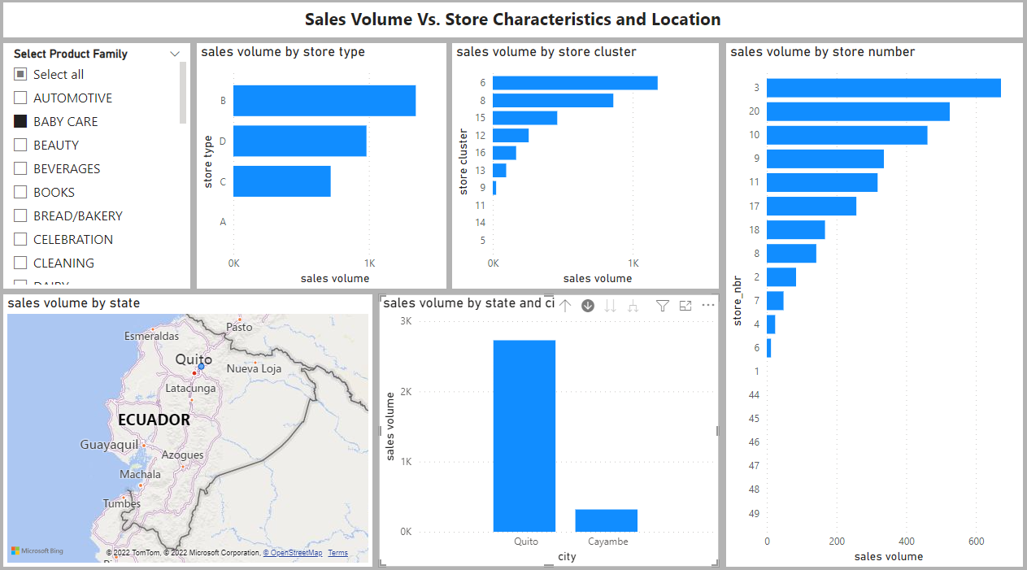
Descriptive Analysis – Impact of Store location/characteristics
For baby care products:
Store type B had the highest sales volume
Store cluster 6 had the highest sales volume
Store number 3 had the highest sales volume
City “Quito” had the highest sales volume

Slide 7
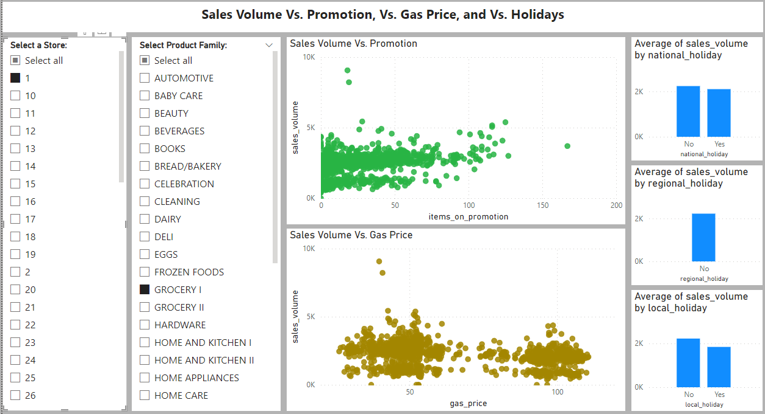
Descriptive Analysis – Impact of Promotion, Gas Price and Holidays
For “Grocery I” product category at store number 1:
The promotion scatterplot shows that Items on promotion is positively correlated with sales volume. In other words, if more items are promoted, more items in this product family can be sold.
The gas price scatterplot shows that gas price is not found to have a clear correlation with the sales volume.
Holidays, surprisingly, is associated with a slight decrease of sales volume as compared to non-holiday days. One assumption is that some families may travel during holidays and thus may reduce the need for groceries.

Slide 8
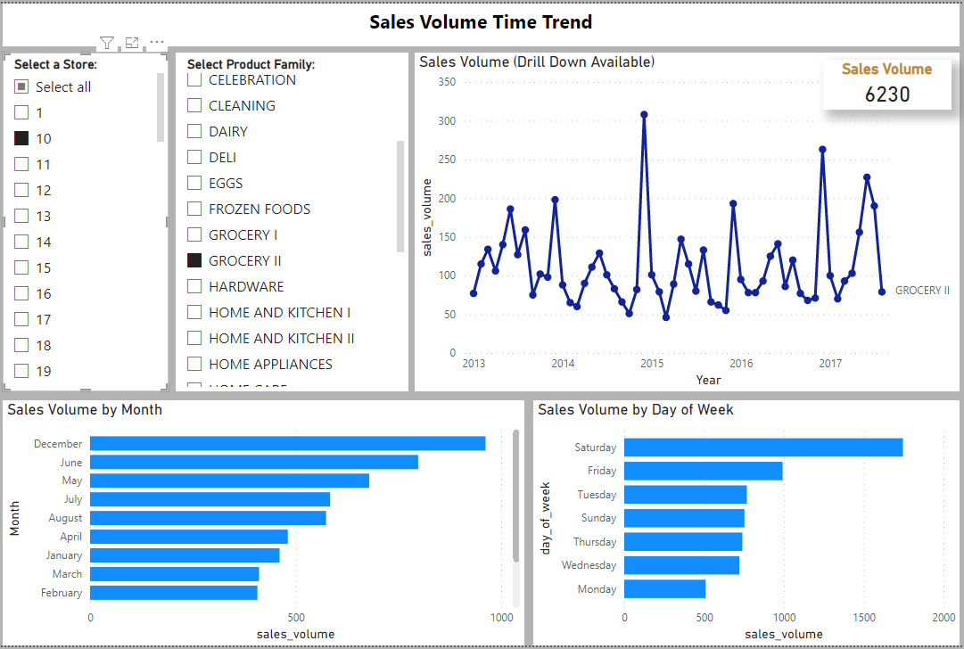
Descriptive Analysis – Time Trend (year, month, day of week)
For “Grocery II” product category at store number 10:
The line graph indicates month seasonality, with a sales spike in December.
The month bar chart shows December is the month that generates highest sales volume.
The day of week bar chart suggests Saturday generates highest sales volume, while Monday has the lowest sales volume.

Slide 9
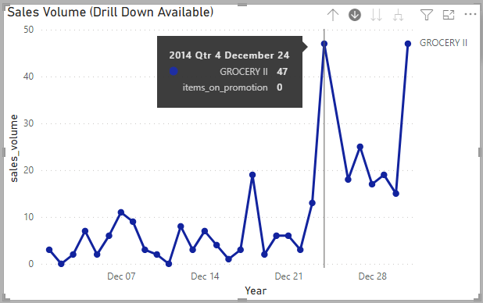
Descriptive Analysis – drill down to find which day has highest sales
For “Grocery II” product category at store number 10:
Drilling down from month to day level for year 2014, we can find that December 24, which is Christmas Eve, has the biggest sales volume.

Slide 10
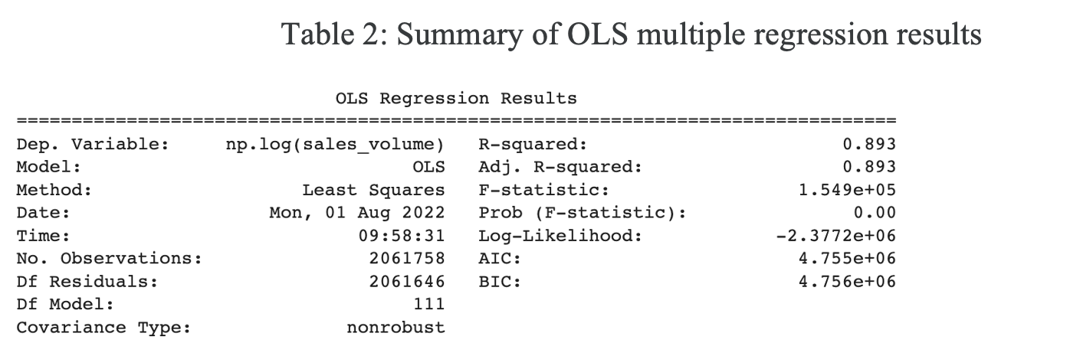
Predictive Analysis – Multiple regression using Python
Predictors:
product family, store number, holidays, gas price, number of items on promotion, year, month, day of week
Regression Results:
R-squared: The regression model has an adjusted R-squared of 0.893, meaning this model can explain 89.3% of the variance of the sales volume in this dataset. The p-values indicated that all the included predictors are statistically significant (p<0.05).

Slide 11
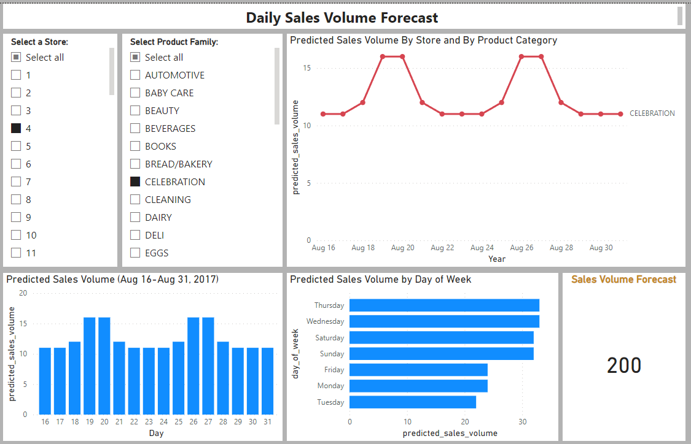
Predictive Analysis– Dashboard for the forecast
Use slicers to select a store and a product family to see the forecast. For example, select store #4 and “Celebration” product family will provide a dashboard view as shown here.

Slide 12
References
Ali, Z. G., Sayın, S., van Woensel, T., & Fransoo, J. (2009). SKU demand forecasting in the presence of promotions. Expert Systems with Applications, 36(10), 12340–12348. https://doi.org/10.1016/j.eswa.2009.04.052
Arunraj, N. S., Ahrens, D., & Fernandes, M. (2016). Application of SARIMAX Model to Forecast Daily Sales in Food Retail Industry. International Journal of Operations Research and Information Systems, 7(2), 1–21. https://doi.org/10.4018/ijoris.2016040101
Badorf, F., & Hoberg, K. (2020). The impact of daily weather on retail sales: An empirical study in brick-and-mortar stores. Journal of Retailing and Consumer Services, 52, 101921. https://doi.org/10.1016/j.jretconser.2019.101921
Chu, C. W., & Zhang, G. P. (2003). A comparative study of linear and nonlinear models for aggregate retail sales forecasting. International Journal of Production Economics, 86(3), 217–231. https://doi.org/10.1016/s0925-5273(03)00068-9
Falatouri, T., Darbanian, F., Brandtner, P., & Udokwu, C. (2022). Predictive Analytics for Demand Forecasting – A Comparison of SARIMA and LSTM in Retail SCM. Procedia Computer Science, 200, 993–1003. https://doi.org/10.1016/j.procs.2022.01.298
Fredén, D., & Larsson, H. (2020). Forecasting Daily Supermarkets Sales with Machine Learning (Dissertation). Retrieved from http://urn.kb.se/resolve?urn=urn:nbn:se:kth:diva-276483
Hirche, M., Haensch, J., & Lockshin, L. (2021). Comparing the day temperature and holiday effects on retail sales of alcoholic beverages – a time-series analysis. International Journal of Wine Business Research, 33(3), 432–455. https://doi.org/10.1108/ijwbr-07-2020-0035
Ma, Y., Ailawadi, K. L., Gauri, D. K., & Grewal, D. (2011). An Empirical Investigation of the Impact of Gasoline Prices on Grocery Shopping Behavior. Journal of Marketing, 75(2), 18–35. https://doi.org/10.1509/jmkg.75.2.18
Silva, A. L., & Cardoso, M. G. (2005). Predicting supermarket sales: The use of regression trees. Journal of Targeting, Measurement and Analysis for Marketing, 13(3), 239–249. https://doi.org/10.1057/palgrave.jt.5740150
Store Sales - Time Series Forecasting. (n.d.). Kaggle. Retrieved August 10, 2022, from https://www.kaggle.com/competitions/store-sales-time-series-forecasting/data
Tabak, B. M., Silva, T. C., Zhao, L., & Sensoy, A. (2020). Applications of Machine Learning Methods in Complex Economics and Financial Networks. Complexity, 2020, 1–2. https://doi.org/10.1155/2020/4247587
Tsoumakas, G. (2018). A survey of machine learning techniques for food sales prediction. Artificial Intelligence Review, 52(1), 441–447. https://doi.org/10.1007/s10462-018-9637-z
Vallés-Pérez, I., Soria-Olivas, E., Martínez-Sober, M., Serrano-López, A. J., Gómez-Sanchís, J., & Mateo, F. (2022). Approaching sales forecasting using recurrent neural networks and transformers. Expert Systems with Applications, 201, 116993. https://doi.org/10.1016/j.eswa.2022.116993
Wang, C. H. (2022). Considering economic indicators and dynamic channel interactions to conduct sales forecasting for retail sectors. Computers & Industrial Engineering, 165, 107965. https://doi.org/10.1016/j.cie.2022.107965

